Slide 1


Slide 2
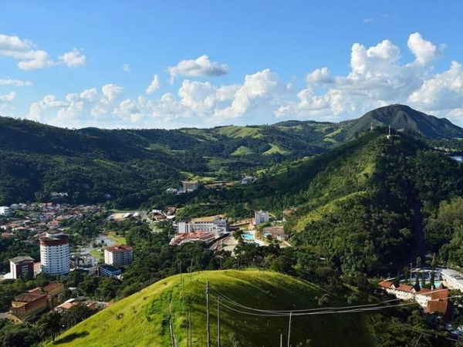
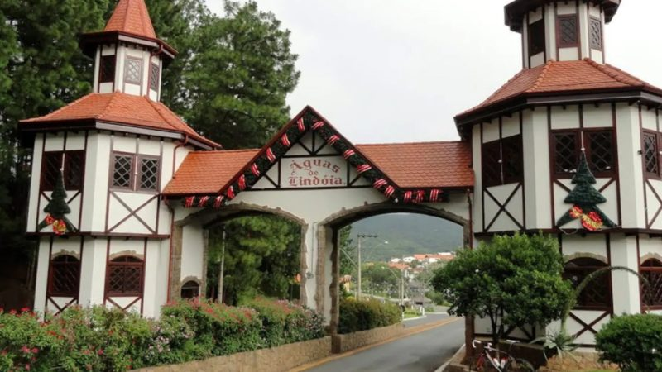
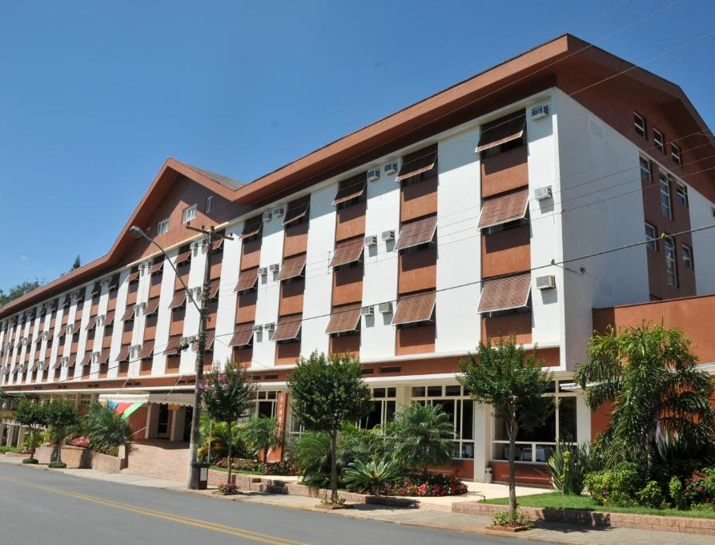
Aguas de Lindoia
Sao Paulo,
Brasil

Slide 3
PROGRAM CONCEPT (15-20 OCT 24)
15 OCT | 16 OCT | 17 OCT | 18 OCT | 19 OCT | 20 OCT | 21 OCT
TUESDAY TERÇA-FEIRA | WEDNESDAY QUARTA-FEIRA | THURSDAY QUINTA-FEIRA | FRIDAY SEXTA-FEIRA | SATURDAY SÁBADO | SUNDAY DOMINGO | MONDAY SEGUNDA FEIRA
ARRIVALS TRANSPORT BETWEEN AIRPORT AND HOTEL | FULL DAY OF CONFERENCE VP BREAKOUTS FLAG CEREMONY WELCOME DINNER / JANTAR DE BOAS VINDAS | FULL DAY OF CONFERENCE VP PRESENTATIONS (15min X 14 VPs) CEREMONY AND DINNER WITH BRAZILIAN AUTHORITIES & DONORS | 3/4 DAY OF CONFERENCE LOCAL TOUR & CULTURAL ACTIVITIES EVENING WITH ORCHESTRA FROM MILITARY POLICE | FULL DAY OF CONFERENCE CONCLUSION & CLOSING FAREWELL DINNER / JANTAR DE DESPEDIDA | WORSHIP SERVICE LUNCH DEPARTURE OF DELEGATES QUINQUENNIAL (HALF-DAY) | QUINQUENNIAL (FULL DAY) DEPARTURE OF REMAINING DELEGATES

Slide 4
WCon-24 Theme and Purpose
WCon-24 Theme: “Arise and Shine” (Isaiah 60:1)
WCon-24 Purpose: That all participants be envisioned, equipped, and encouraged to accomplish AMCF’s goal/ mission for the growth of Christ’s kingdom and God’s glory.
AMCF’s mission: To bring the good news (Gospel) of Jesus Christ to military men and women of every nation of the world.
AMCF’s goal: That every nation in the world has a military Christian fellowship that becomes mature and effective.
Focus: Discipleship, equipping, building relationships, and encouragement rather than evangelism since most participants (except some VIPs) should be believers already.

Slide 5
WCon-24 Goals
Prepare future AMCF leaders and help forge a common global vision and strategic approach for AMCF future ministry.
Build unity among military Christians worldwide (Jn 17:20-23) by sharing testimonies of God’s faithfulness that display and build on Gal 3:28
Strengthen existing relationships and partnerships and build new ones
Foster spiritual encouragement for participants.
Engage in united worship
Clearly define the conference goals and keep them a priority during program development and speaker choice

